Slide 1
IOT 2020/21 Project Proposal Option 1: VP-Dibris Smart Parking
INTERNET OF THINGS - 90524
«Group Members»
Muhammad Sulaman Toor 5049761
Gowthami Ramakrishnegowda 5056130
Muhammad Umair Yosuf 4977898

Slide 2
Project Goal: To define requirements, architecture and prototype of an IoT system for Smart Parking to be used to monitor the different parking lots of VP-Dibris.

Slide 3
Project Aim: The monitoring systems will collect data on empty places i) How many empty places, in which parking lot, etc ii) Publishing these information on internal channels for staff members

Slide 4
Project Outcome: i) Maintaining data of every car that entered into the parking lot - Vehicle number plate log - time stamps ii) Provide statistics on the resulting historical information.

Slide 5
(1) Proposal of the architecture of the IoT system with a particular attention on the following points:
types of sensors and edge devices to be used to acquire data
communication infrastructure and middleware
software components for data acquisition, storage and processing, dashboard and visualisation and main functionalities of the different components
interaction schemes (UML-like, state machine etc) that describe the main protocols needed in the system

Slide 6
types of sensors and edge devices to be used to acquire data
Raspberry Pi
Ultrasonic Sensor HRC-04
IP Webcam/Webcam/RPi Camera
Nota a piè di pagina

Slide 7
communication infrastructure and middleware
Nota a piè di pagina

Slide 8
software components for data acquisition, storage and processing, dashboard and visualisation and main functionalities of the different components
Node-Red
HTML
CSS
JS
Firebase Realtime Database
Nota a piè di pagina

Slide 9
Node-Red Palettes used
node-red-contrib-firebase
node-red-contrib-realtime-database
node-red-contrib-image-output
node-red-contrib-onvif
node-red-contrib-plate-recognizer
node-red-contrib-email
Nota a piè di pagina

Slide 10
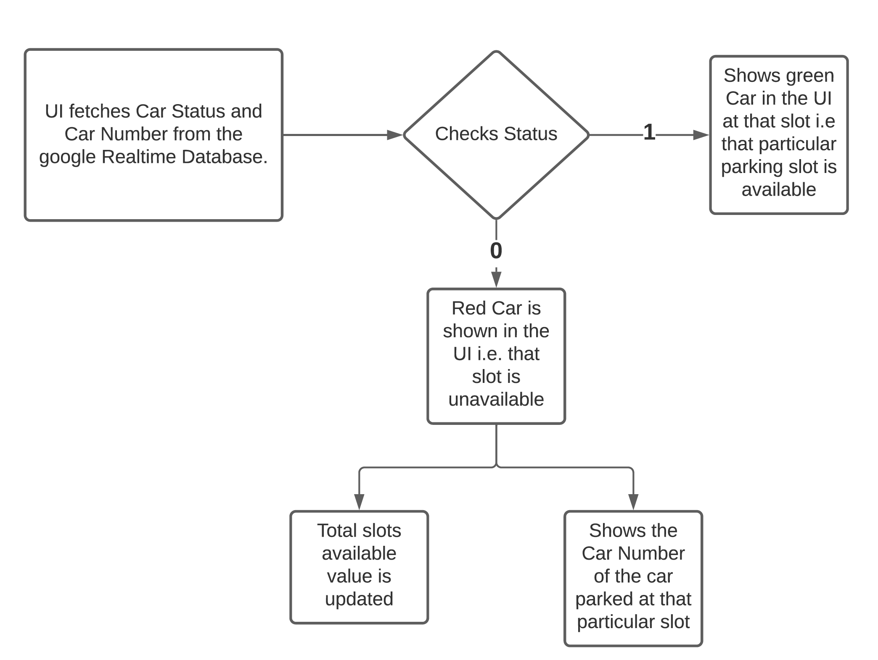
Interaction schemes (main protocols needed in the system)

Slide 11
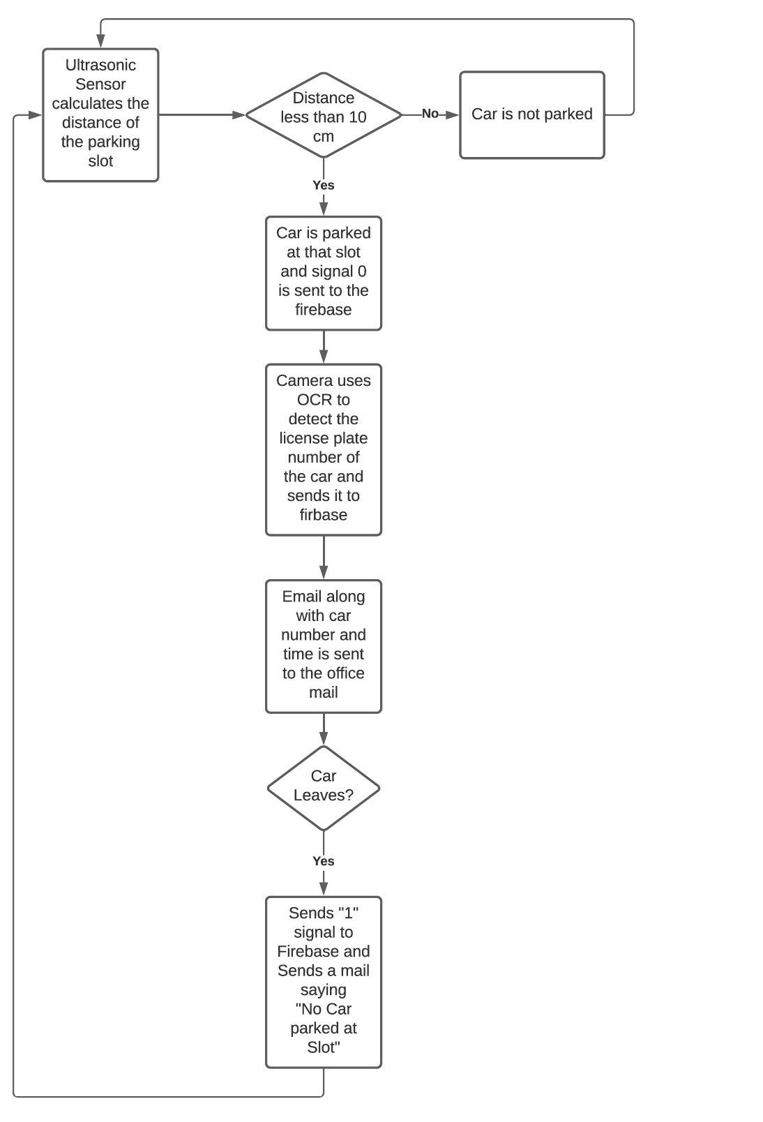
Interaction schemes (main protocols needed in the system)

Slide 12
2) Implement a prototype of the architecture in Node-Red consisting of the following components:
software components for simulating the chosen set of sensors
middleware for data acquisition
processing component and dashboard

Slide 13
software components for simulating the chosen set of sensors
Raspberry Pi
Ultrasonic Sensor HRC-04
IP Webcam/Webcam/RPi Camera (mobile camera)

Slide 14
middleware for data acquisition
Firebase Realtime Database
Nota a piè di pagina

Slide 15
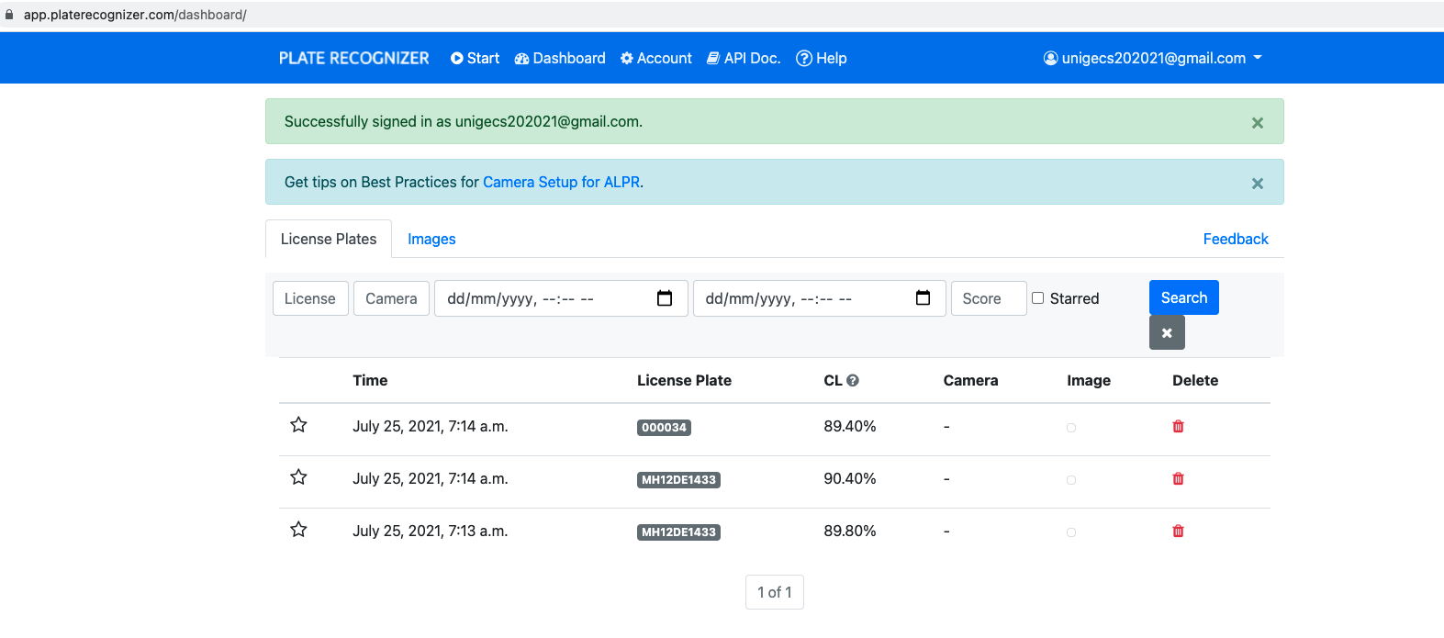
processing component and dashboard
https://app.platerecognizer.com/dashboard/

Slide 16
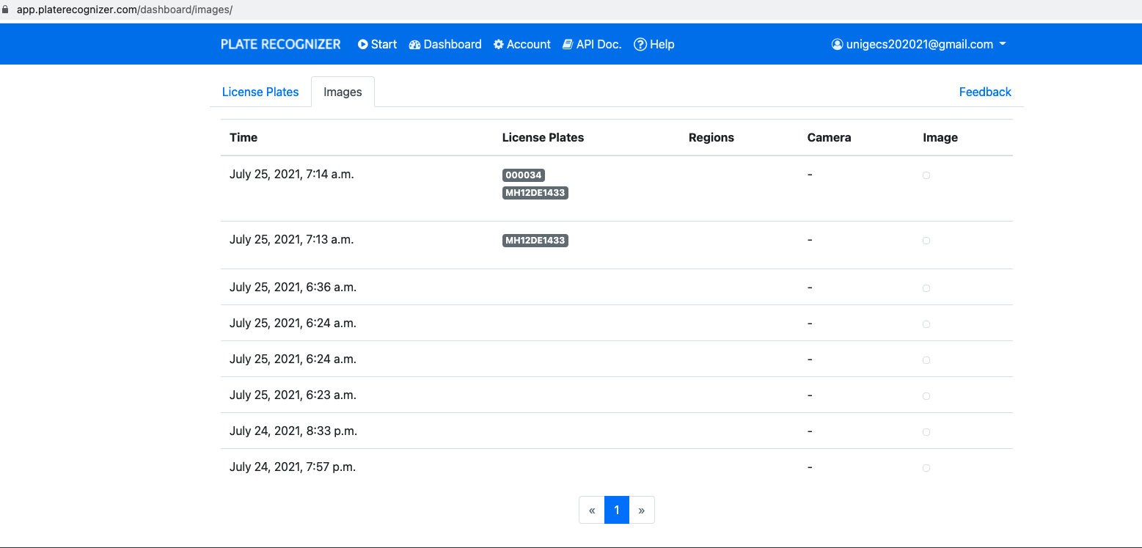
processing component and dashboard
https://app.platerecognizer.com/dashboard/

Slide 17
Working Mechanism – Parking Lot (Vehicle Detection)
Ultrasonic Sensor is present at each parking slots which continuously detects the distance of the parking slot from the top.
If a car enters the parking slot the distance will be less than 10cm and the message “0” will be sent to the database of that slot. (0 means car parked)
As soon as the signal is sent, IP webcam (using android smartphone) which works over the Internet

Slide 18
Working Mechanism – Parking Lot (Vehicle Detection)
It uses OCR to detect the License Plate Number of the car
A preview of the image captured & is shown in the UI.
It then sends the data to the database of that slot.

Slide 19
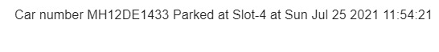
Working Mechanism – Parking Lot (Vehicle Detection)
After detecting the license plate of the car an email is sent to the admin’s office email in which
“Car Number Parked at Slot-Number at time” is written.
Nota a piè di pagina

Slide 20
Working Mechanism – Parking Lot (Vehicle Detection)
UI continuously fetches data from the database
As soon as it receives the message “0” at any slot it toggles the status of that slot to red color car i.e. That slot is unavailable and shows the Car Number of the car parked in that Slot in the UI.

Slide 21
Working Mechanism – Parking Lot (Vehicle Detection)
If the car leaves the parking slot the distance from Ultrasonic Sensor to ground becomes greater than 10cms and message “1”
It sent to the database and an email is generated in which “No car parked at slot Slot number”.
As soon as “1” is sent the car status is updated in the UI and that slot is shown available.
Nota a piè di pagina

Slide 22
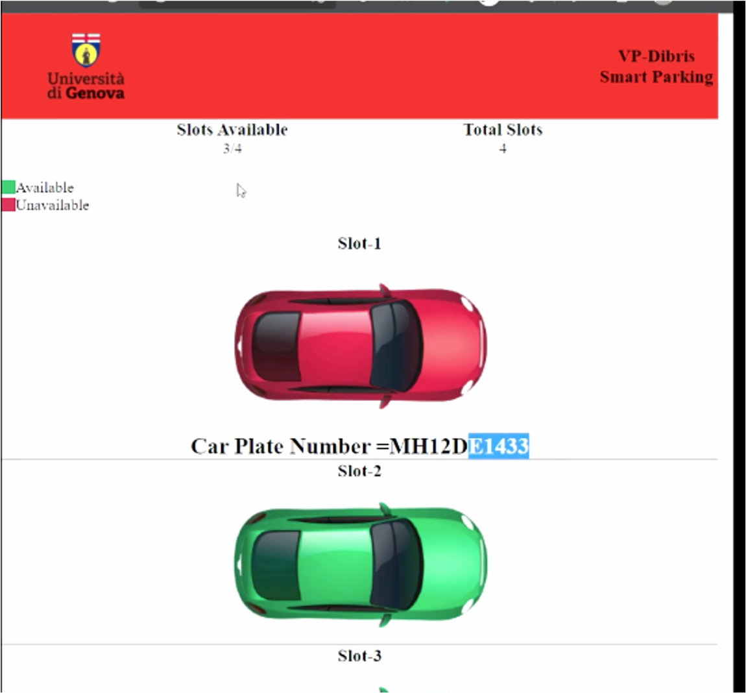
Working Mechanism – Parking Lot (Vehicle Detection)

Slide 23
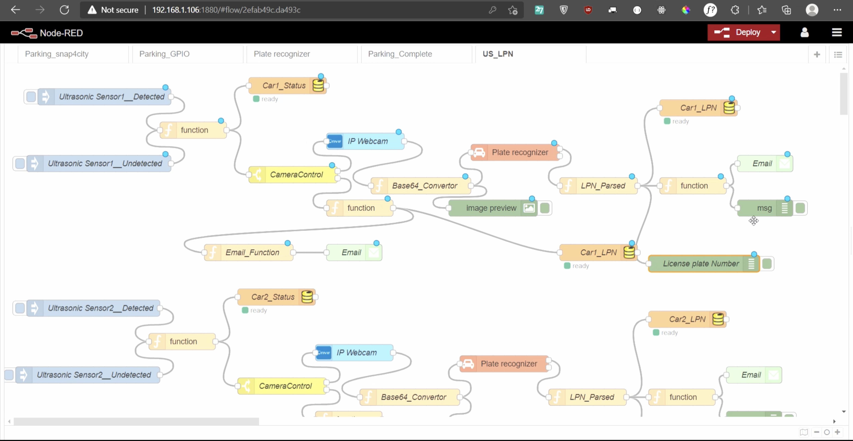
Node-Red Flow

Slide 24
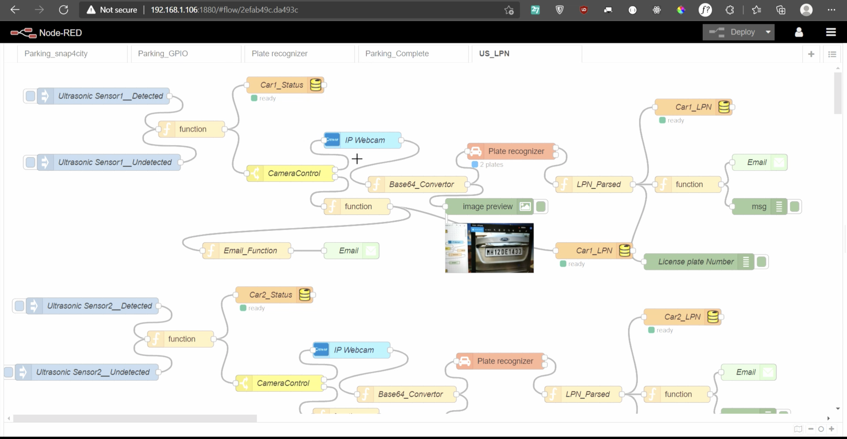
Node-Red Flow (License Plate OCR)

Slide 25
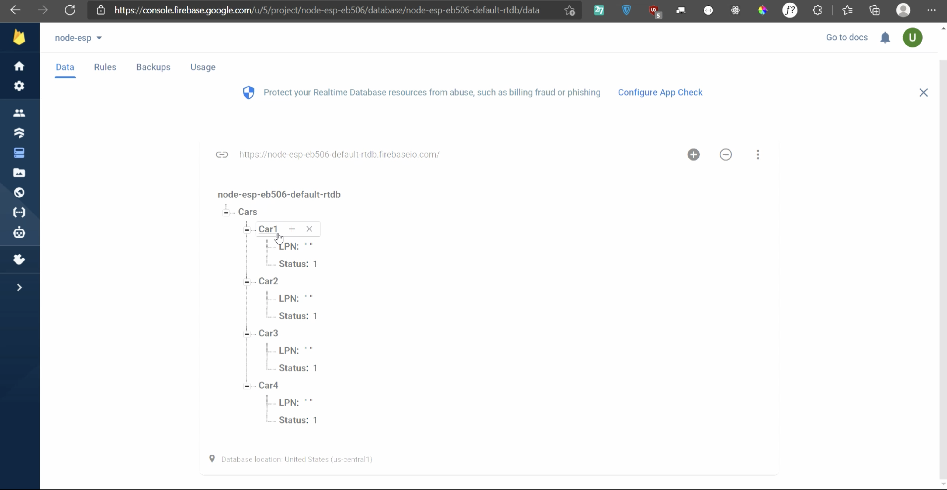
Firebase – Google

Slide 26
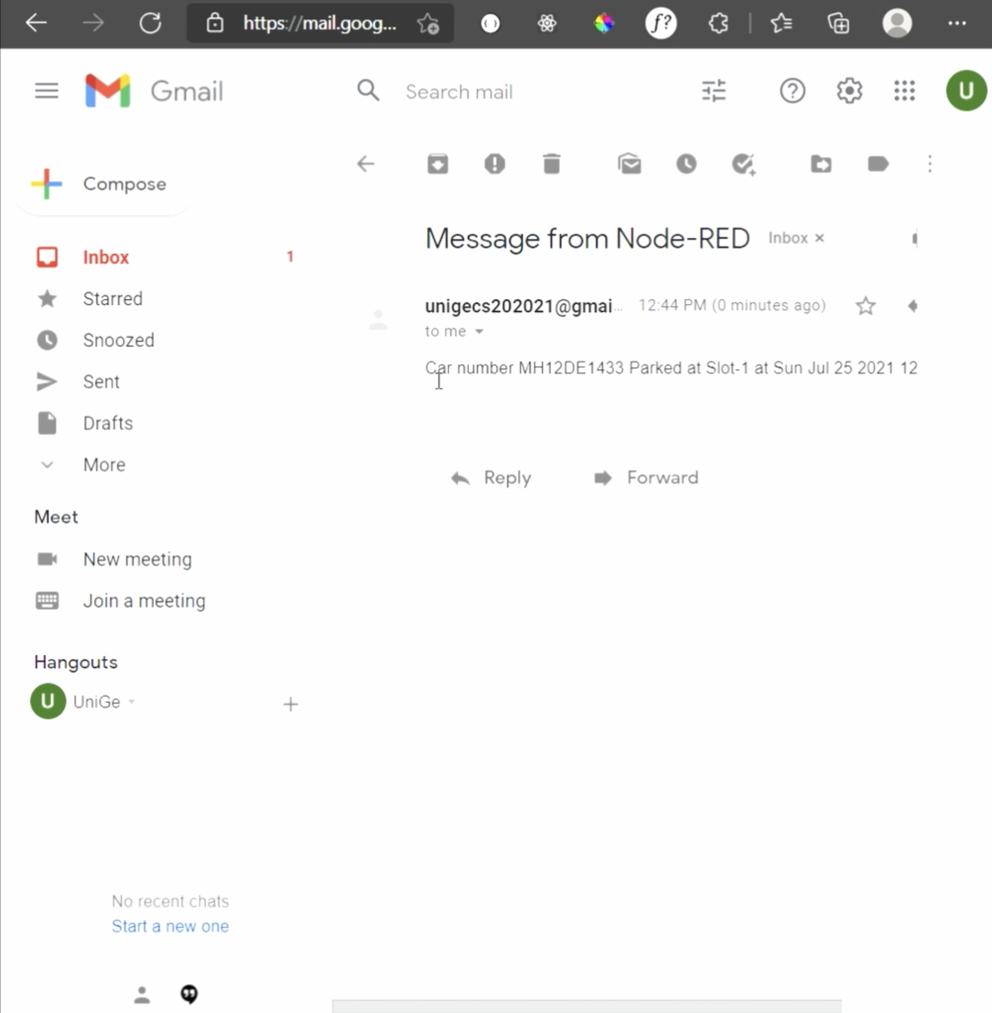
Car Parked Email Notification

Slide 27
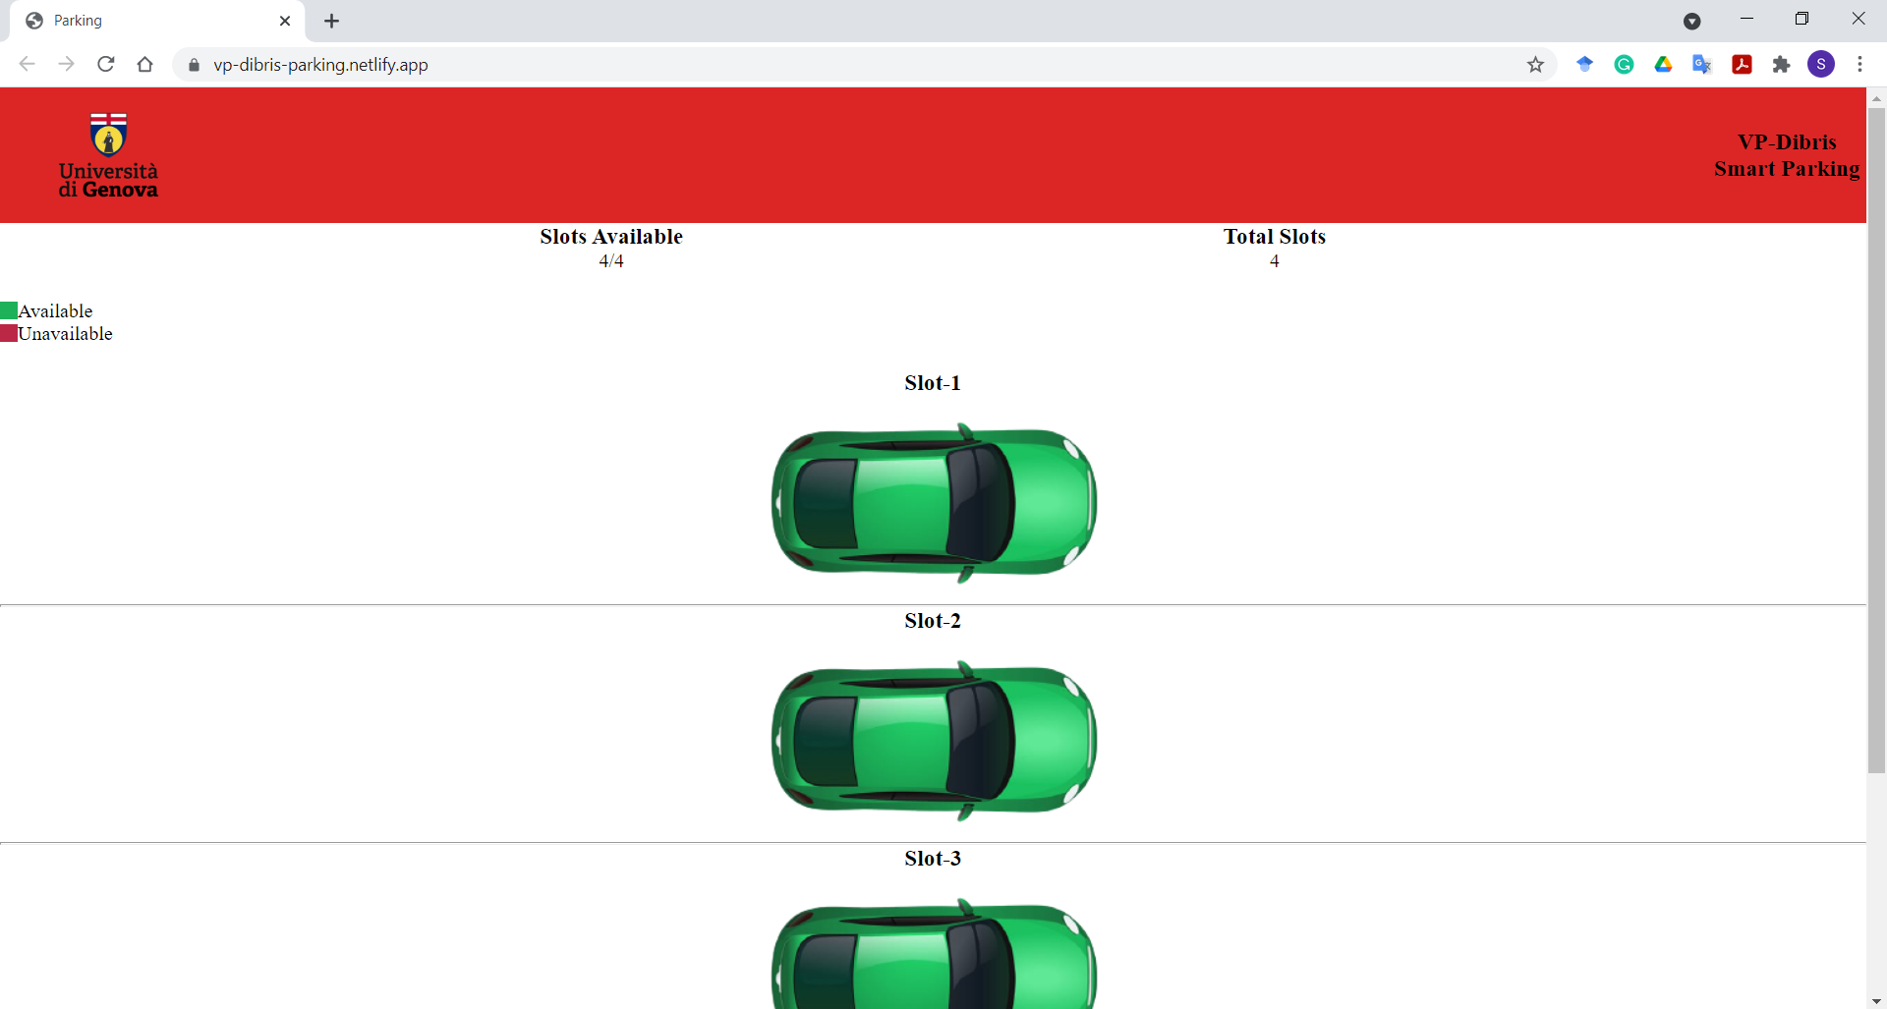
Web Portal for Parking log (Public)
https://vp-dibris-parking.netlify.app/

